Slide 1



15-688 Final Project
Opening weekend
Box Office Analysis
Rongpeng Zheng
Sihan You
Zhexi Liu

Slide 2

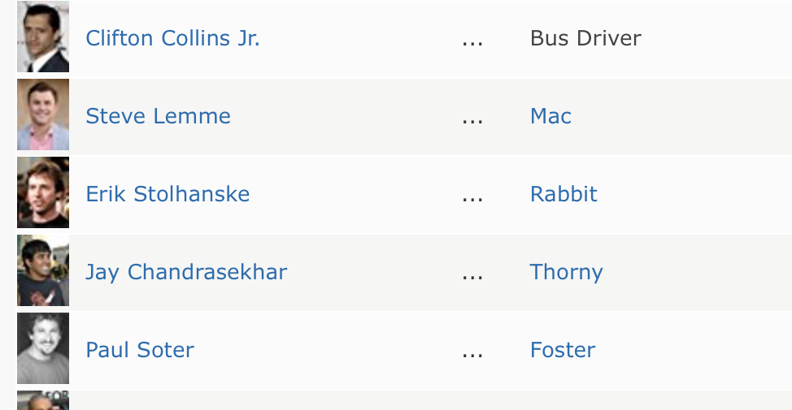
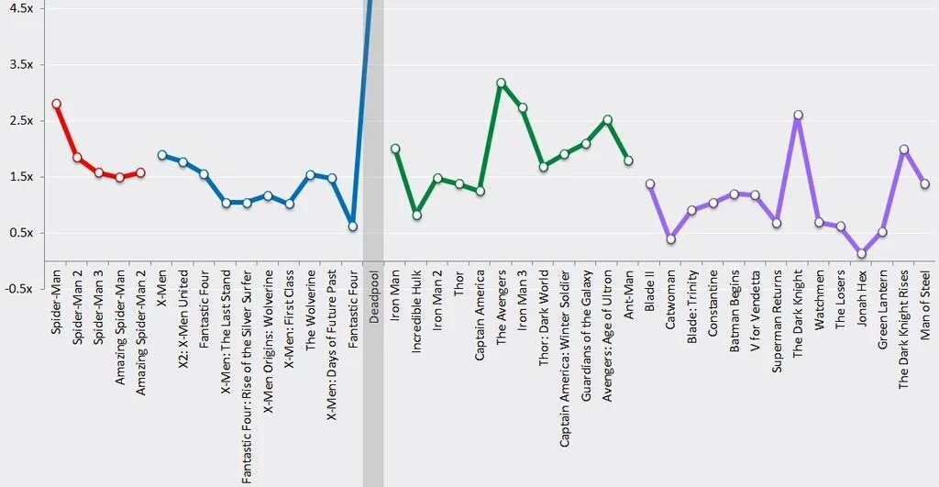
Motivation
Pre-production casting period:
Investors can make better decisions about which production crew and actors to use.
Pre-release period:
Adjust budget (e.g., on movie promotions. Technical investments). Timing.
After film is released:
Allow theatre to arrange show times wisely (maximize profit).
Can also be used to shift audience decisions.

Slide 3
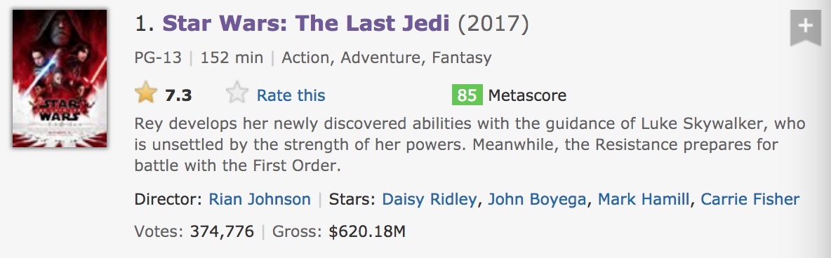
Query IMDB with parameters (year, page)
Filter page don’t have box office information
Use Requests to get the web pages
Of certain movie
Use Beautiful soup to parse the html and extract features
Store the file in CSV format
Data Collection
Notes:
The data collection method for model 1 is to use python’s library: Requests and beautiful soup to download and parse the html. We extract many features from the web page of imdb and filter out the movie that have box office to be our target information. We will store the information in CSV format, which will be easy for our model to read

Slide 4
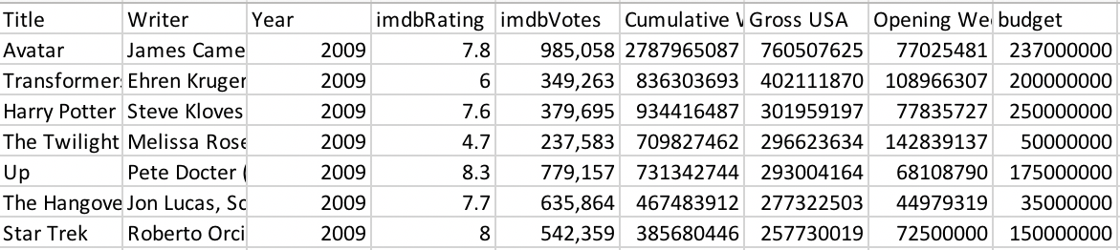
Dataset Analysis
Nominal Features:
Actors
Production
Directors
Writers
Categorical Features:
Year
Month
Genre
Rated
Country
Numerical Features:
Budget
Runtime
…
Statistics
5200 raw movies metadata, 3025 rows after cleaning.
Movies data are from IMDB, released from 2004 – 2017

Slide 5
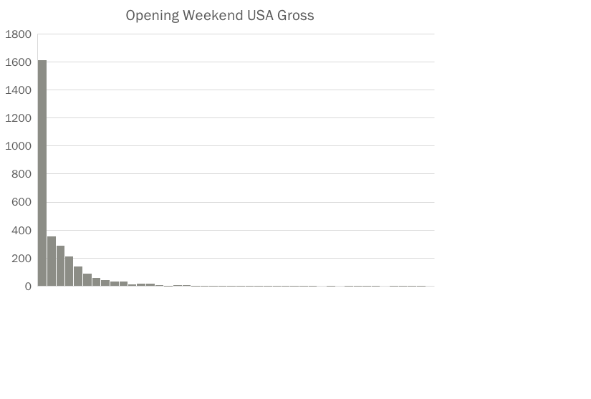
Dataset Analysis
Gross distribution
Gross range from $65 to $247,966,675
44% of movies get box office < 100M, and 56% above

Slide 6
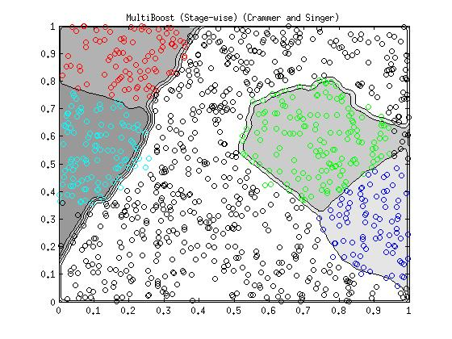
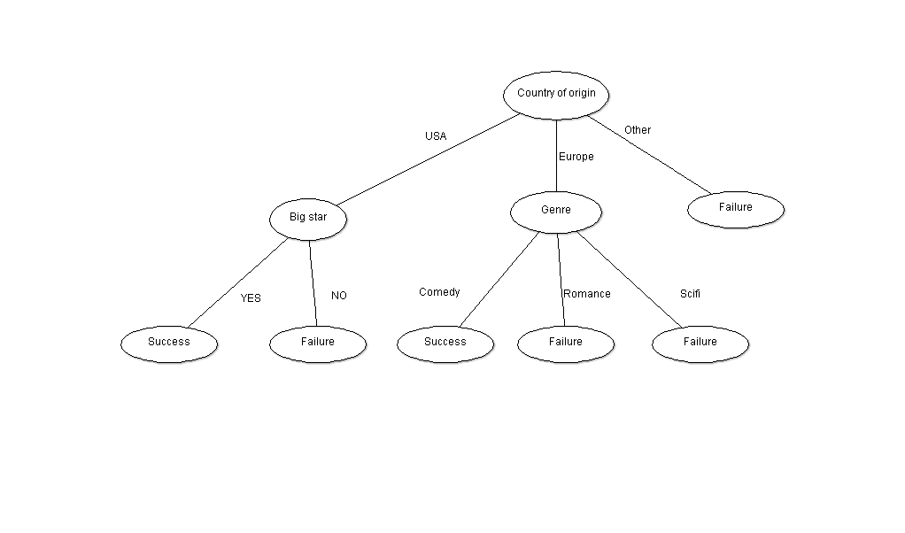

Models
Logistic Regression, SVM, Decision Tree
One-hot-encoder for non-numeric features
Tried labeling between binary (2) to up to 24 classes

Slide 7
Result
Baseline: 55%
Logistic regression achieve the best accuracy of average 72.9%
Decision tree is the second with 67.2% accuracy on average

Slide 8
Result Analysis
Top Influential Actors
Kristin Scott Thomas (0.005306)
Dwayne Johnson (0.004891)
Hugh Jackman (0.004289)
Samuel L. Jackson (0.004277)
Anna Kendrick
(0.004172)
Johnny Depp
(0.004110)
Will Ferrell
(0.004053)
Nicolas Cage
(0.003917)

Slide 9
Top Productions
1.
2.
3.
4. 20th Century Fox
5. Paramount Pictures
6. Walt Disney Pictures
7. IFC Films
Other Potential Valuable features: Director, Release date, Budget, Genre, Rated, Runtime

